Slide 1

Honey Production in the USA (1998-2012) By way of US Honey Production 1995 - 2021
Margaret Bowers, NYCDSA
Data Analysis Project with Python
September 2024
Notes:
My name is Margaret Bowers.
I am a student with NYC Data Science Academy.
This is my first time exploring a dataset with Python.
I chose for my first data set to look at Honey Production in the US.

Slide 2
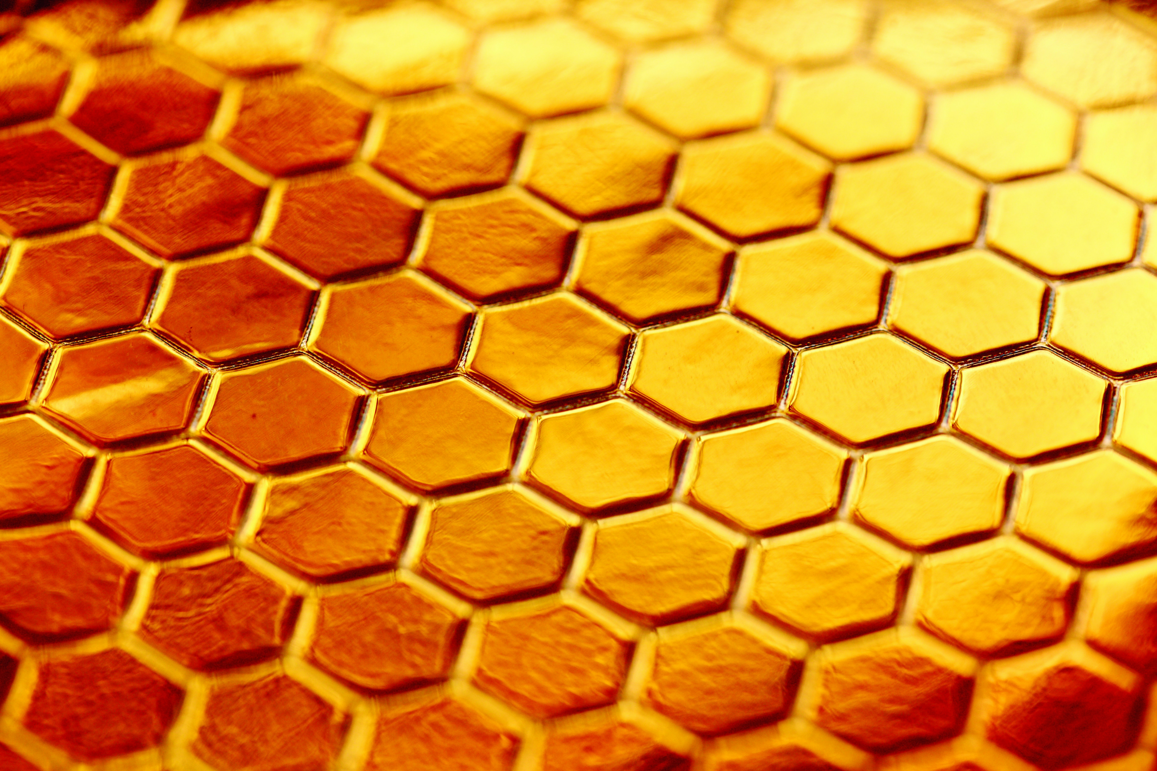
Introduction
Purpose of This Project
Questions I Addressed
Photo by Alexander Grey, Unsplash
Notes:
Introduction:
I chose this dataset because:
straightforward
had a user rating of 10
wanted something well-behaved for my first dataset.
The primary source for this data was the USDA’s National Agricultural Statistics Service (NASS). They collect data from a wide range of agricultural sectors and provide statistics for agricultural workers and people who depend on agriculture for their livelihood. Honey production is just one subset of the data they collect.
[NEXT SLIDE:]
Purpose of this Project:
I know a little bit about declining numbers of bees in the US, and I wanted to see this was reflected in the data. I was a little surprised that I did not see a sharp ‘event’ in 2006, when Colony Collapse Disorder (CCD) was officially reported, although there is a general decline in the number of bee colonies and the total honey produced over time.
I also wanted to learn something about who the largest producers of honey are in the US.
Which states are the top producers?
If you were setting up a business producing honey, which states would be a good choice?
What considerations should a small honey producer consider, vs. a large honey producer?
NEXT SLIDE:
Questions I addressed:
I thought this would be pretty straightforward.
During the course of my Exploratory Data Analysis, I discovered that my dataset was not usable.
Fortunately, I found a second data set that was comparable and had usable data.
Once I verified that the new data frame was in good shape, I was ready to go.
After looking at national consumption trends, I looked more closely at individual states. I zeroed in on the top producers and compared their stocks and production levels to the rest of the states.

Slide 3
Exploratory Data Analysis
US Honey Production 1995 – 2021​
EDA
Features: ​
state​
number of colonies
yield per colony
total production​
stocks
average price
value of production
year
No null values
Missing data:
Missing 6 states
6 states did not have data for every year
Average Price of Honey
Unbelievable range in price:
$1.30 to $874.00
Dollars to cents
Notes:
The first data set: US Honey Production 1995-2021
Features:
Units - pounds and dollars (purportedly)
EDA:
[ANIMATION:]
No null values.
[ANIMATION:]
Missing data:
6 states were missing entirely from the data set. (Alaska, Conn, DE, Mass, NH, RI all missing)
6 states did not have data for every year. (KY, MD, NV, NM, OK, SC were all missing data.)
In my research, I discovered that some states' data (ex RI) are not included in reports for proprietary reasons.
At this point - still had 38 states with data I could use.
I could already see that the price was fishy.
Based on other Kaggle notebooks I thought this was something I could fix.

Slide 4
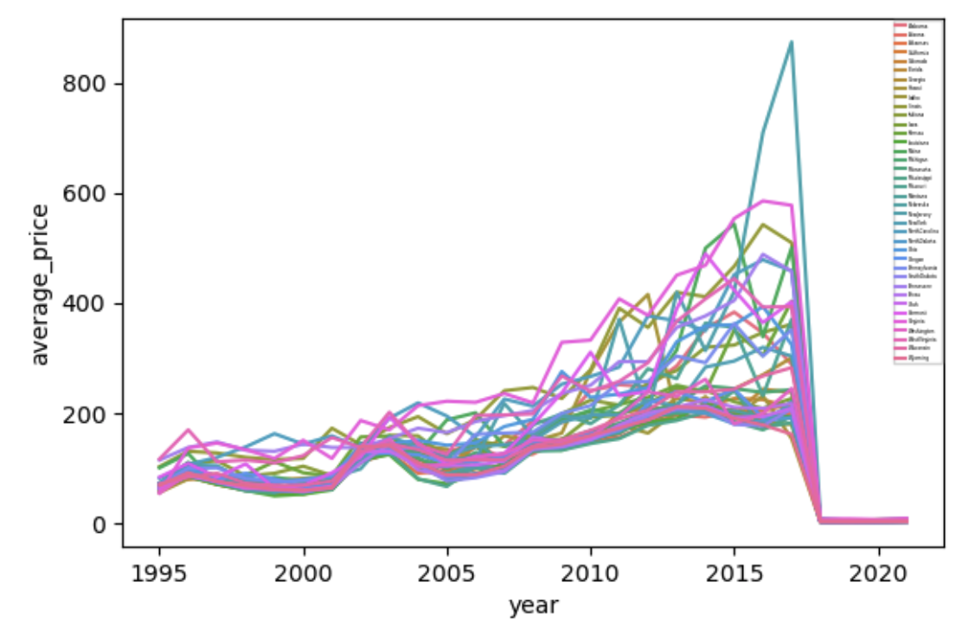
First look at average price in 1995-2021 dataset
Notes:
Visualizing the data clearly shows that something is wrong with the average price field. I examined the numbers more closely and saw that starting in 2018, they had decreased by a factor of 100.
USDA reports for that time period indicate that honey data had been updated in 2018 to dollars per pound from cents per pound.
I scaled the errant numbers by a factor of 100 starting in 2018, and continued with my EDA.
(Did not visualize this in the presentation because there are bigger problems coming).

Slide 5
Exploratory Data Analysis
US Honey Production 1995 – 2021​
EDA
Features: ​
state​
number of colonies
yield per colony
total production​
stocks
average price
value of production
year
No null values
Missing data:
Missing 6 states
6 states did not have data for every year
Average Price of Honey
Dollars to cents
Derived columns:
Value of production != price*production
Total production != colonies*yield
Notes:
Because value of production is derived from average price, I assumed that would also be off by a factor of 100 starting in 2018.
When I looked at those values, there was no indication that they were off by a factor of 100. They were just all over the place, with no pattern to their error.
[Value of production is defined as the product of average price and total production.]
I looked at another derived field: total production is defined to be the product of number of colonies and yield per colony.
This was also not true. And there was no discernable pattern to this error (i.e, no factor of 100, or so).
So, if the derived quantities are incorrect, should I fix the data and move ahead?
Can I trust the independent variables they are based on?
Should I just fix the data?
Were the independent fields trustworthy?
Looking a little more closely at stocks, which are not derived from anything, I discovered that in 2010, they become equal to total production, which is absolutely incorrect.
In USDA reports, at no time are stocks and total production ever the same.
So now I was looking at a data set with corrupted, derived variables, as well as independent variables that I did not believe.
I deemed the dataset unusable.

Slide 6
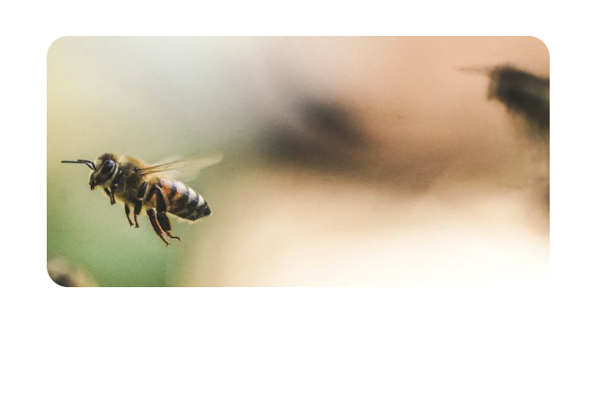
Honey Production in the USA (1998 - 2012)
Photo by Eric Ward on Unsplash
Notes:
Fortunately, there was another data set on Kaggle that had comparable data and seemed better behaved.

Slide 7
Exploratory Data Analysis
Honey Production in the USA 1998 – 2012
EDA
Features: ​
state
number of colonies ​
yield per colony ​
total production ​
stocks
average price ​
value of production ​
year
No null values
Missing data:
Missing 6 states
4 states did not have data for every year
Average Price of Honey
Consistent throughout
Believable price range:
$0.49 to $4.15
Notes:
The new dataset looked very similar to my first one. Similar features and some of the values for fields were the same.
There were also notes in the Kaggle data card about how this data was redone, going back to original sources.
I repeated my EDA.
Six states missing entirely: the same as in the previous data set: Alaska, Conn, DE, Mass, NH, RI
Only four states are missing data: MD, NV, OK, SC. These were also missing from the first data set. KY and NM.
Checked the average price of honey.
The numbers seem much more believable with a maximum of $4.15/lb compared to $847.00/lb

Slide 8
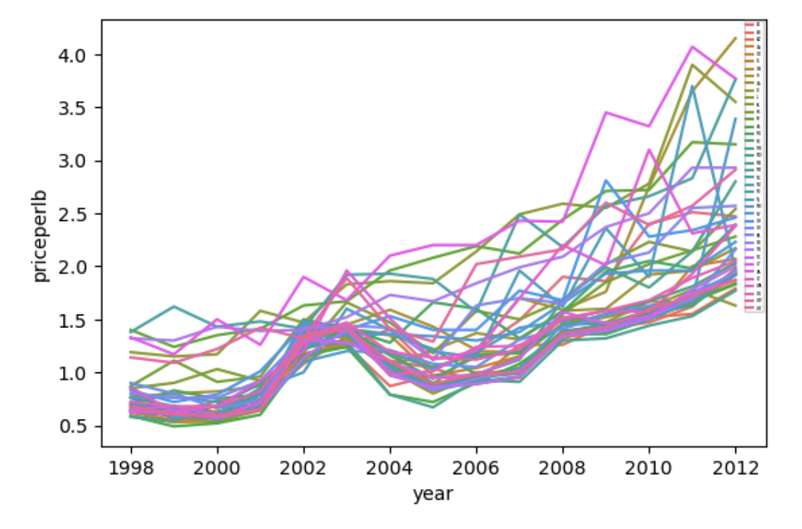
Average price per pound from 1998 - 2012
dataset
Notes:
Looking at the price data, this looks much better.

Slide 9
Exploratory Data Analysis
Honey Production in the USA 1998 – 2012
EDA
Features: ​
state
number of colonies ​
yield per colony ​
total production ​
stocks
average price ​
value of production ​
year
No null values
Missing data:
Missing 6 states
4 states did not have data for every year
Average Price of Honey
Consistent throughout
Derived columns:
Total production = colonies*yield
Value of production != price*production
Notes:
I verified that
total prod = numcol * yieldpercol
prodvalue != totalprod * priceperlb, due to rounding errors.
totalprod * priceperlb = prodvalue_exact
I examined this difference in the exact values and the rounded values and observed that the difference was less than .23 percent for all states,
and less than .03 percent for most states. I decided this was not enough to worry about.
From my EDA, I concluded that:
6 states do not appear in the dataframe: AK, CT, DE, MA, NH, and RI.
4 states: MD, OK, NV, and SC, have incomplete data so I removed them.
Leaving 40 of 50 states fully represented over a 15 year period.
Finally, I had data I was confident in using.

Slide 10
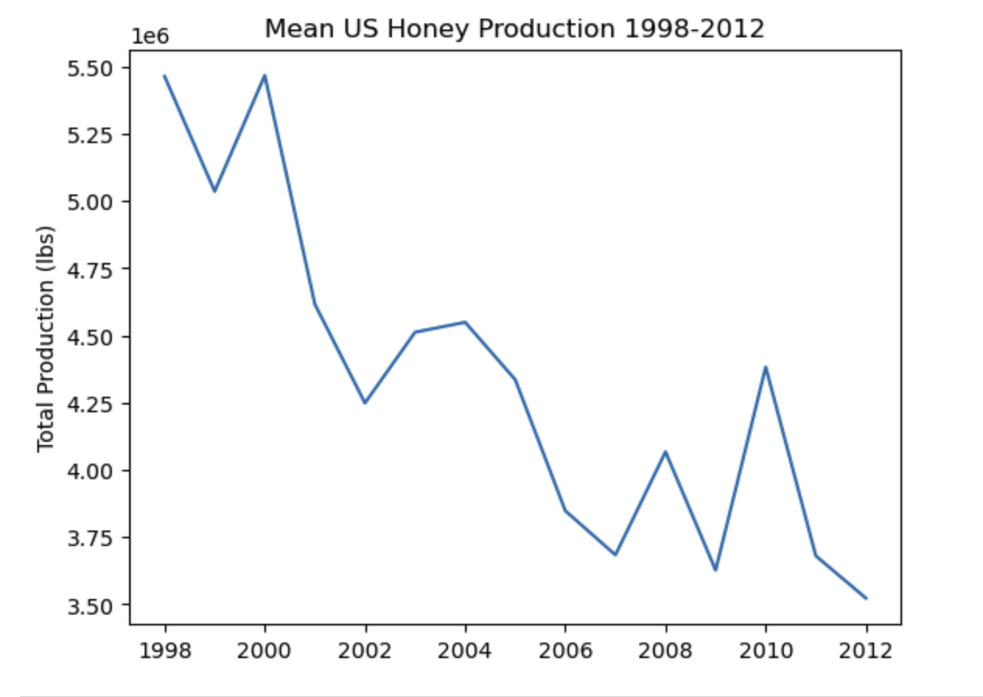
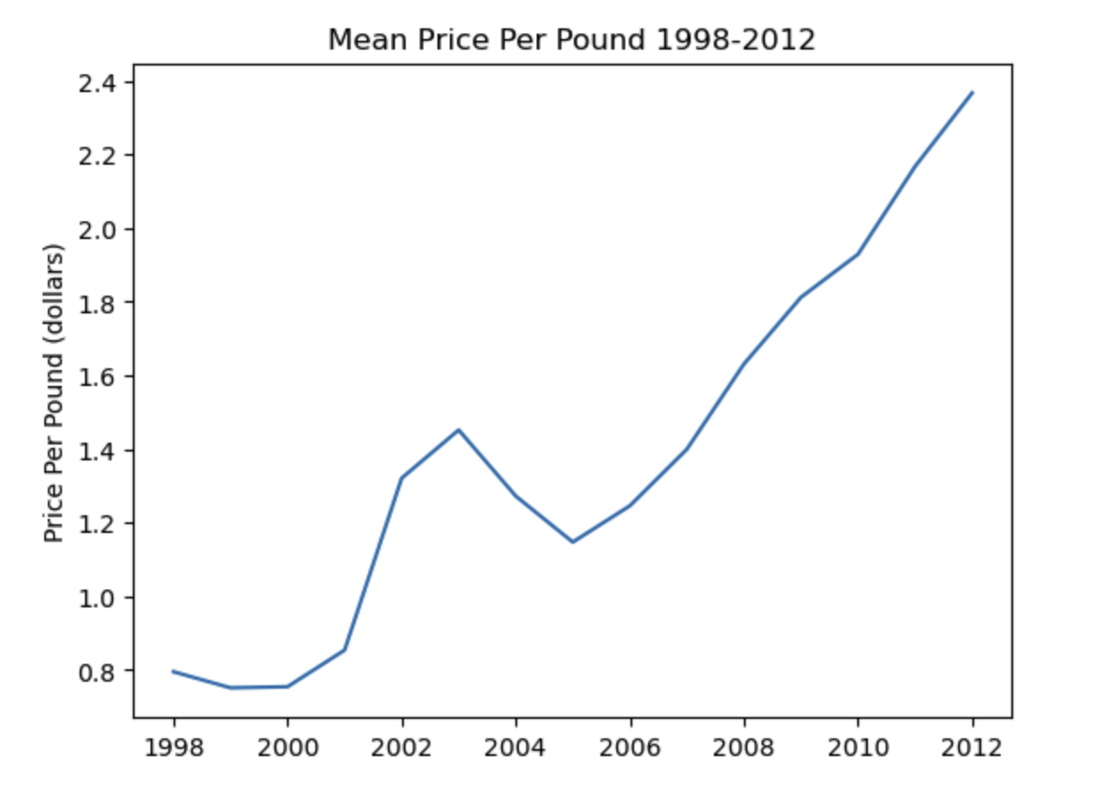
First look at the data:
Notes:
First, I decided to look at National Trends
Consider the big picture of honey production in the US.
These are the mean values of production by year.
Basic observations:
averageprice per pound - generally increasing.
total production - declining

Slide 11
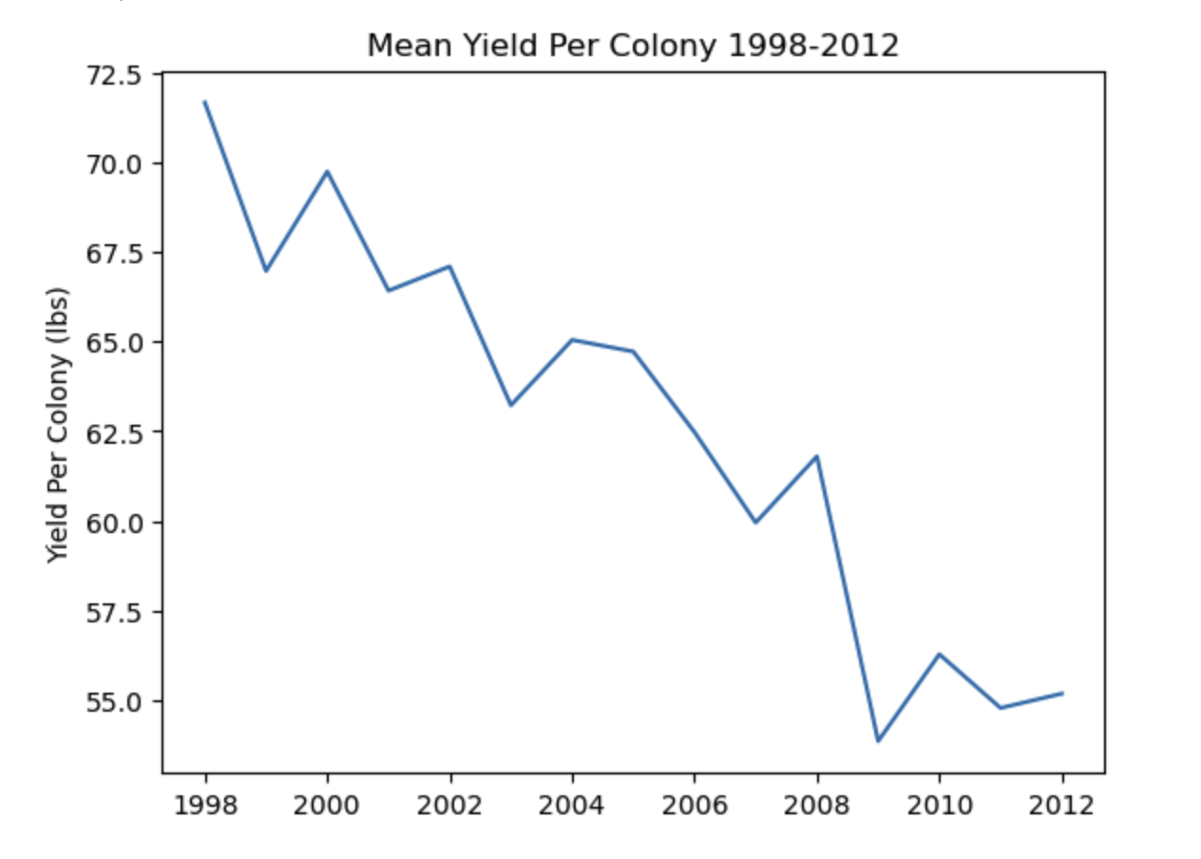
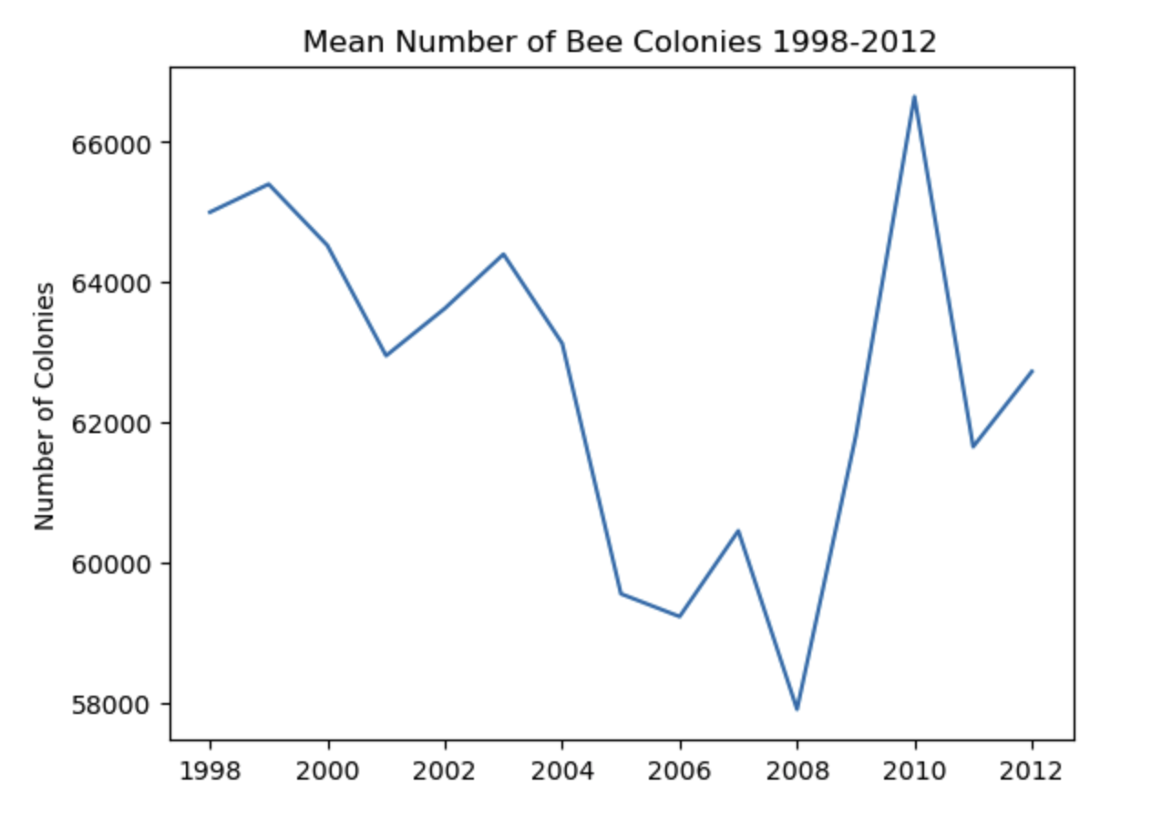
First look at the data:
Notes:
yield per colony - declining.
number of colonies - declining, except for a sharp rise starting in 2009.
Yield is declining even as the number of colonies are going up.
It looks like beekeepers are trying to accommodate for decreasing yields by bulking up their colony numbers.
Aside:
CCD was first officially reported in 2006.
Clearly collapse preceded this - we can see this in the data.

Slide 12
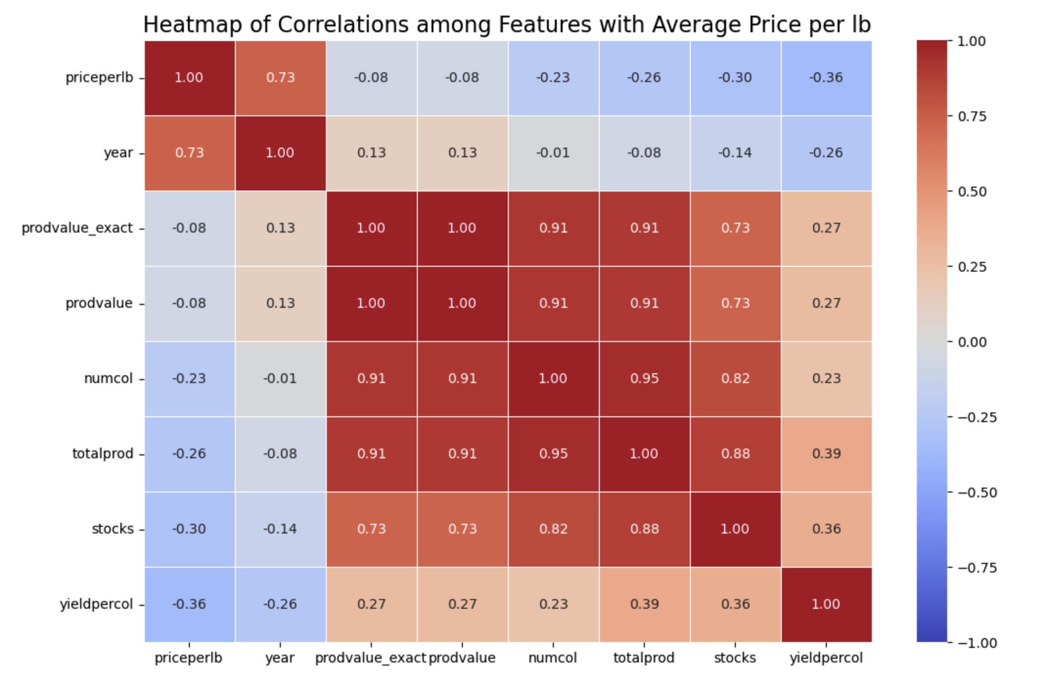
Notes:
Heatmap:
I looked at how the fields correlate to one another:
xxx [Can see that prodvalue_exact and prodvalue are comparable and not significantly different.]
[ Total production derived from numcol*yieldpercol ]
Total production depends more on the number of colonies than on the yield per colony.
Yield per colony is highly variable (weather, beekeeper) - interesting to see that the number of colonies may be the dominant driver of production.
[ Value of production (prodvalue) derived from totalprod*averageprice.
Value of production is strongly correlated to the total production, less so to price
The volume of product is the driver here.
Price is negatively correlated to total production.
Production goes down, price goes up.
Looking a little more closely at price...

Slide 13
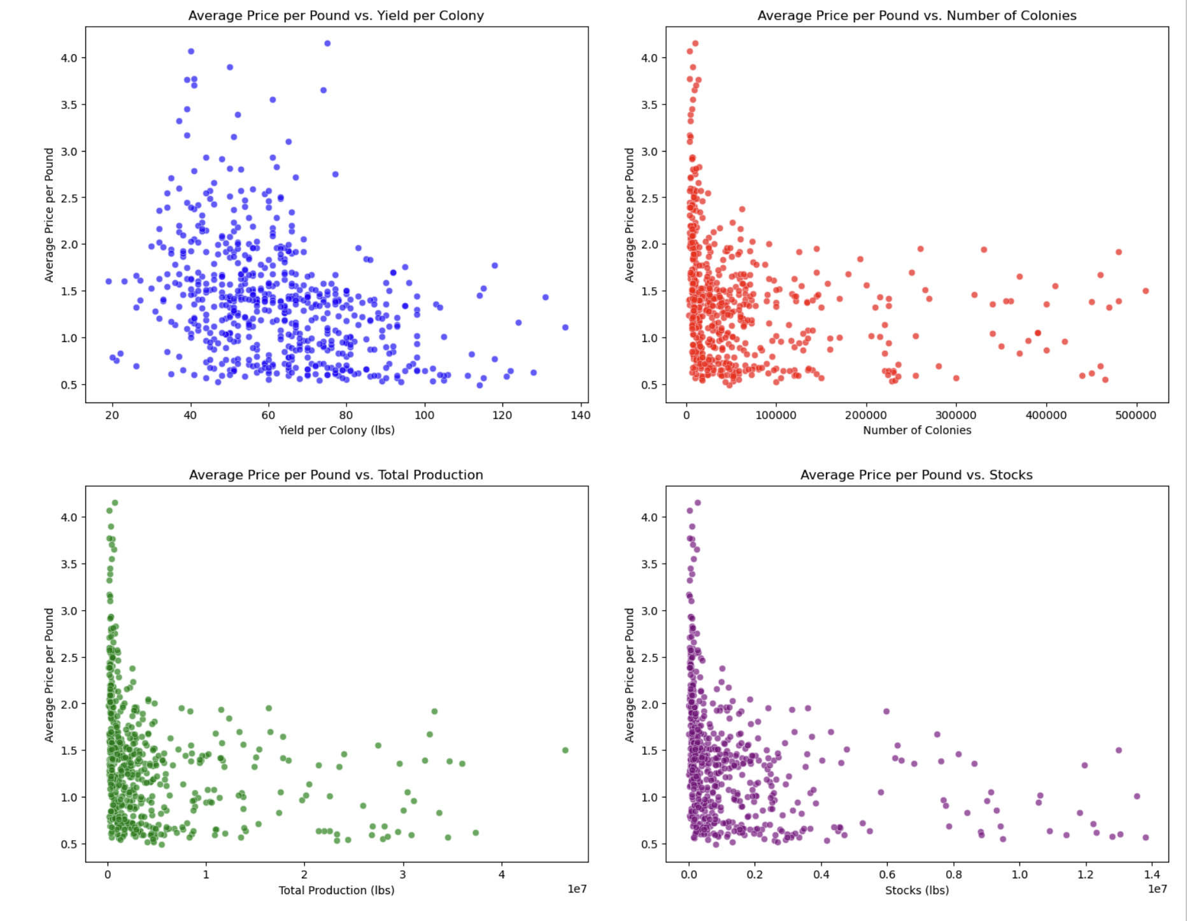
Price compared to:
yield per colony (blue), number of colonies (red),
total production (green), stocks (purple)
Notes:
[Data for all the states]
Blue - Yield per Colony v. Price
Red - Number of Colonies v. Price
Green - Total Production v. Price
Purple - Stocks v. Price
Y-axis: average price
Initial scatterplots of price v. number of colonies, total production, and stocks are hard to interpret because they cluster so much.
But there is a great deal of variability with price and yield per colony.
There looks to be a lot happening on either end.
Bottom right: High yields with some pretty low prices.
Upper left: Lower yields with higher prices.
Aside: I saw in my research that colony yield is highly dependent on the beekeeper and weather
A typical beehive in the US can output between 10 and 200 pounds of honey per year.
So there really is a lot of variability.

Slide 14
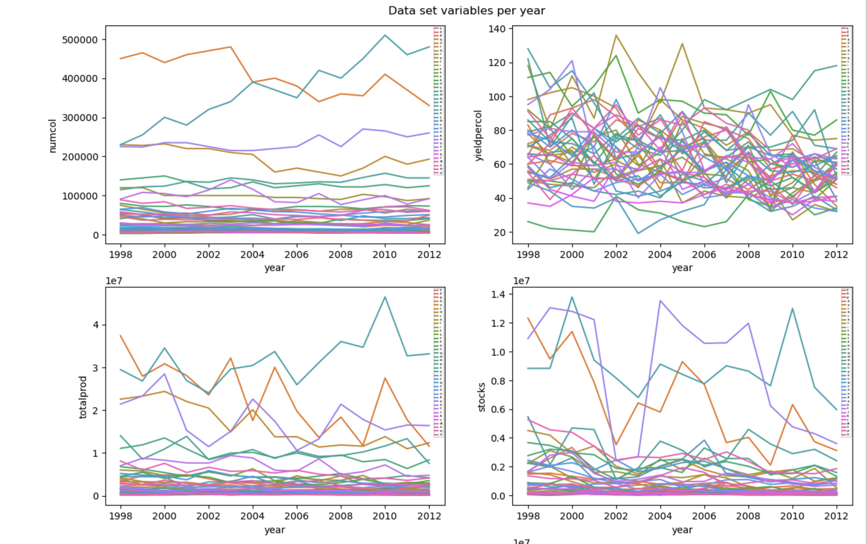
Individual States
Notes:
I wanted to look more closely at individual states:
The graphs:
y-axis: year
numcol yield per colony,
total production stocks
Yield per colony is all over the place. Not surprising, considering the variability.
What struck me - most states cluster together in numbers of colonies, total production, and stocks.
While there are 8-10 states that are outperforming all the rest.

Slide 15
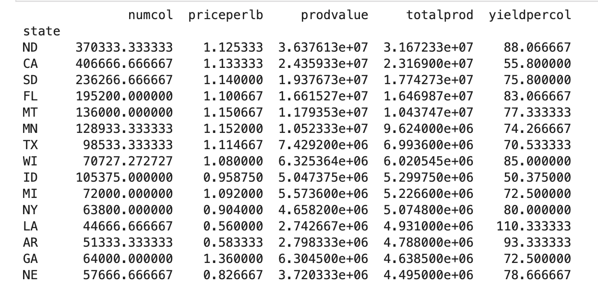
Grouping the data by top performers
Quantiles of total production
Notes:
Grouping the data by top performers (those with highest total production), can see who the winners are.
Not surprising to see CA in the top.
Surprised to see that ND produces the most honey!
[next slide]

Slide 16
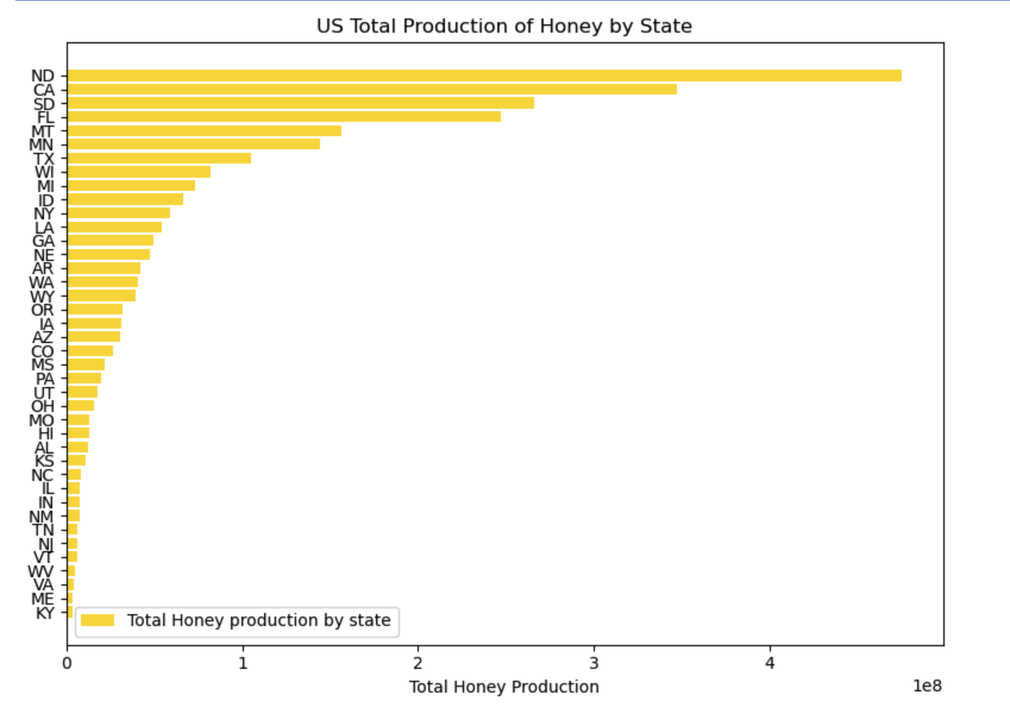
Total Honey Production by State
Notes:
These are the dominant producers that we saw in the line plots.
ND and CA are the winners here.
With SD and FL contributing a lot as well.

Slide 17
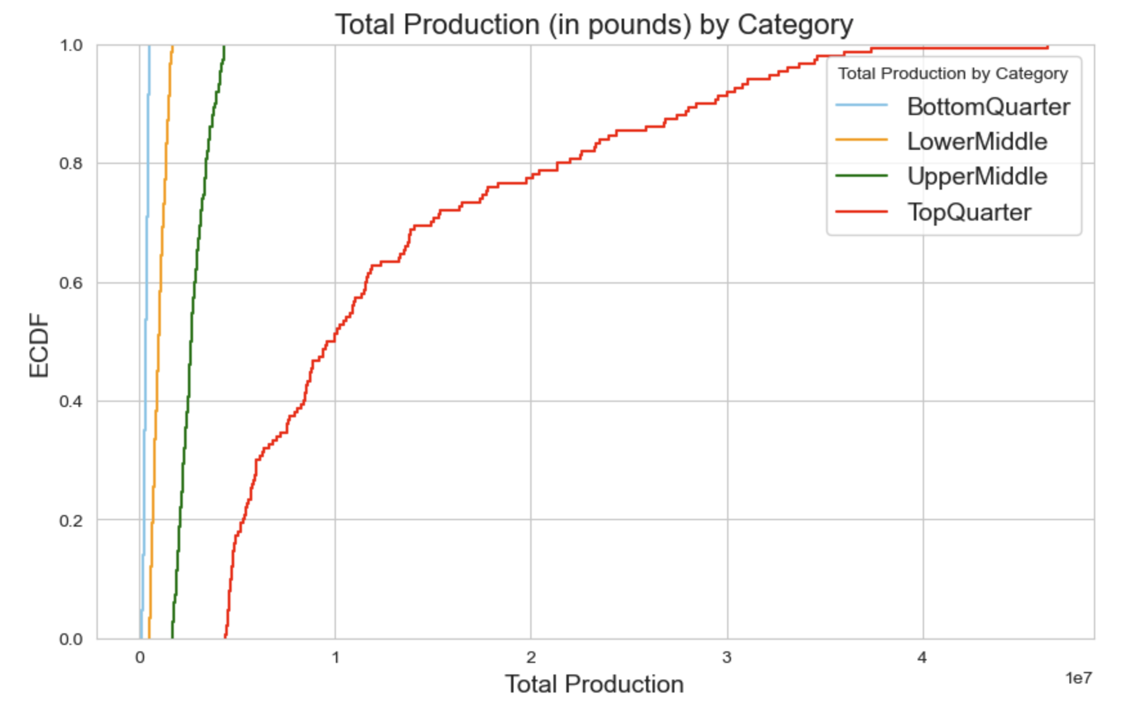
Notes:
Empirical Cumulative Distribution Function:
Looking at quartiles of total production.
Each quartile has 10 states.
The bottom 3 quartiles were tightly grouped, not surprising.
After some refining, I decided to group the bottom 3 quartiles tougher (and a few states from the top tier) into their own quantile.

Slide 18
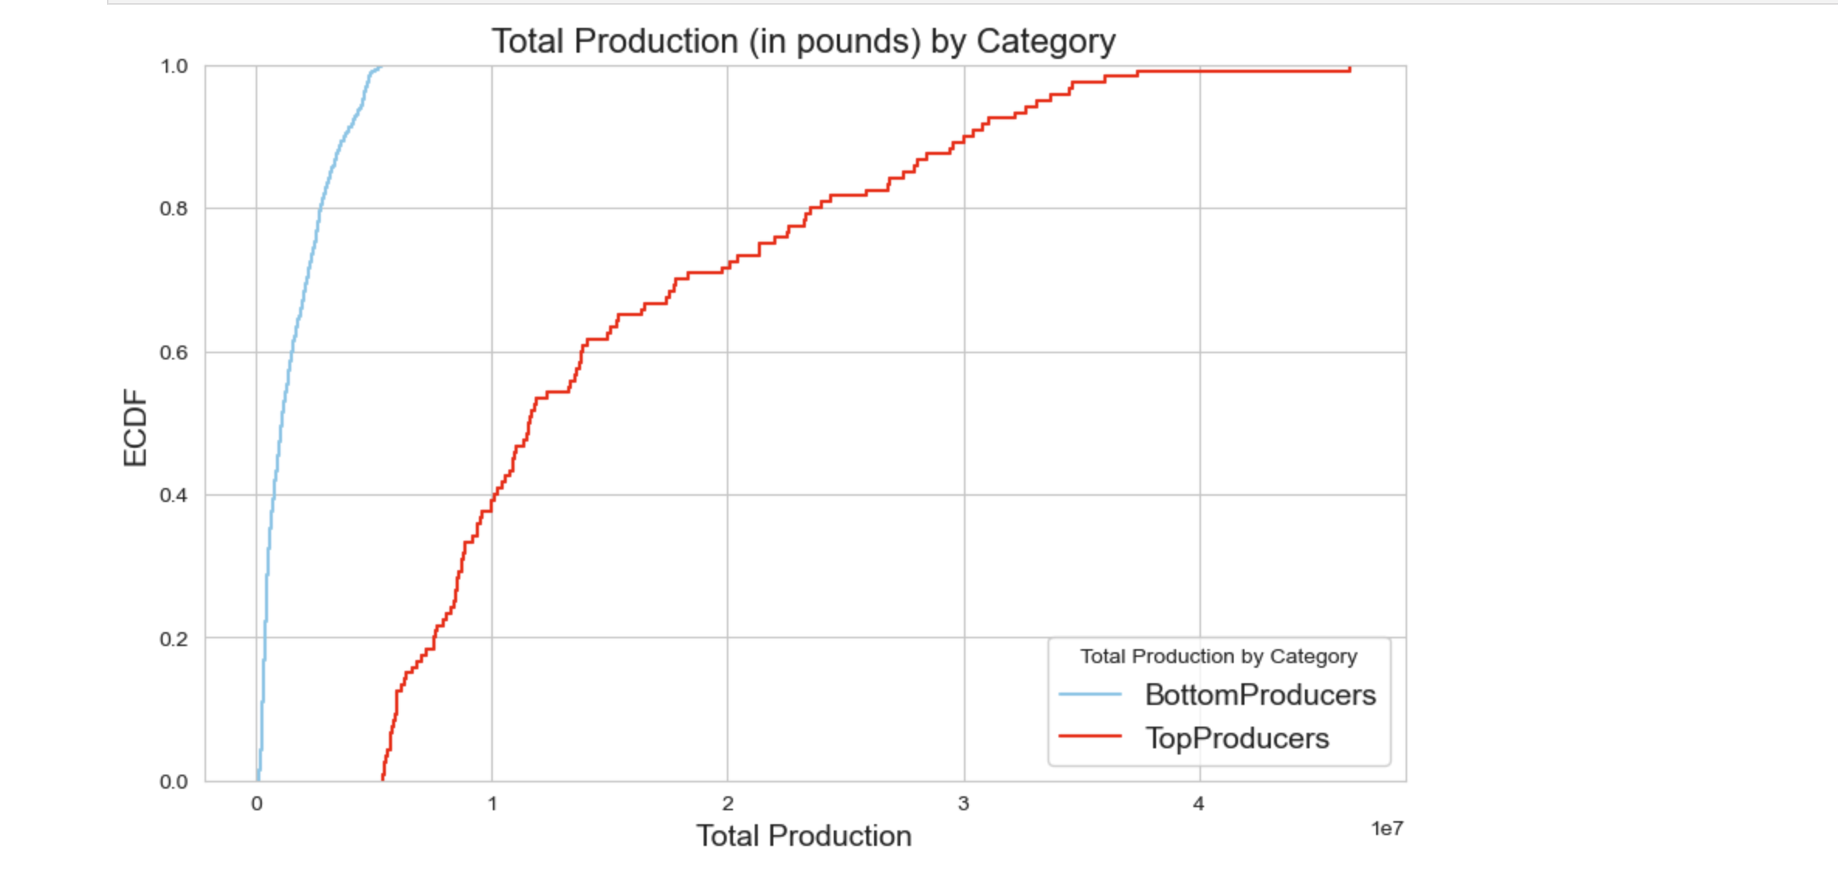
Producers: bottom 80% and top 20%
Notes:
Empirical Cumulative Distribution Function (cont.):
This top tier represent 8 of 40 states:
[ ND, CA, SD, FL, MT, MN, TX, WI ]
What is interesting to me is, we can see that the bottom producers (blue line) were responsible for a little over 5 million pounds of honey.
80% of top producers (red line) produced between 5 and 30 million pounds of honey while 20% of the top producers produced more than 30 million pounds of honey from 1998-2012.
The bottom producers (blue line) have more uniform levels of production while there is a lot of variability in production from the top producers (red line).
Not only do the bottom producers produce less honey, but they have less variability and more uniform production.
Whereas the top states, producing more honey, are more variable.
Who are these producers at the high high end of production? And what is the volume of their contribution?

Slide 19
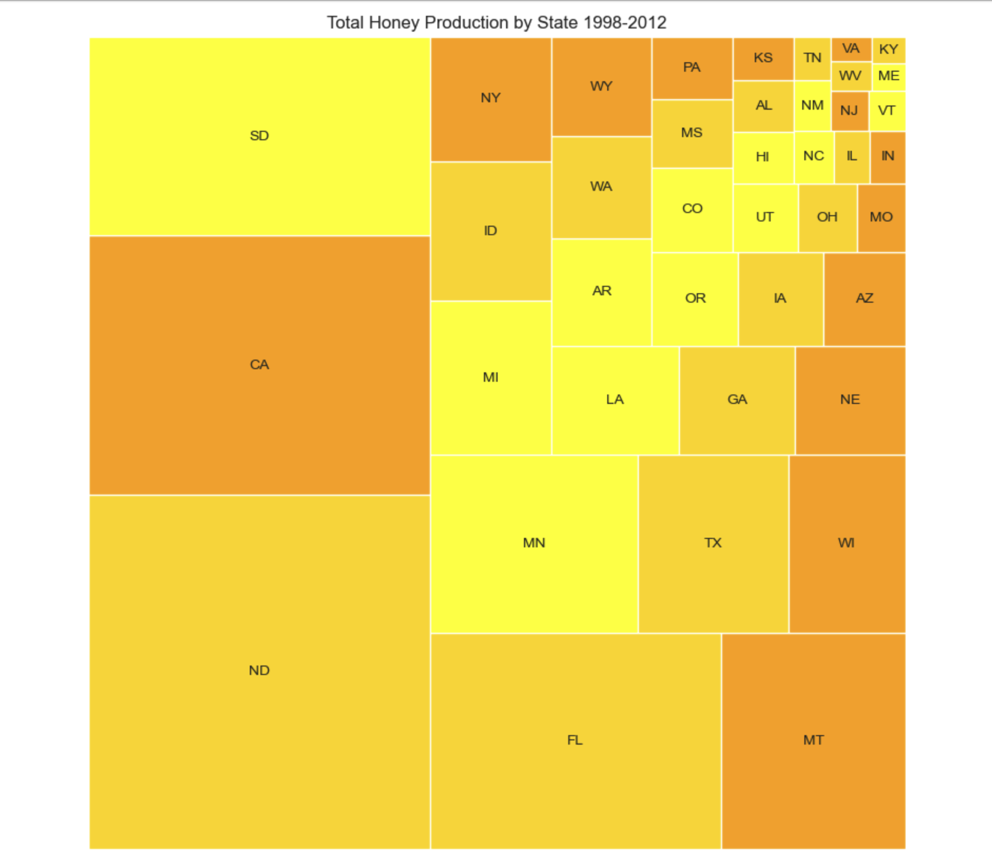
Honey Production by state:
4 states were responsible for over 50% of the total US production of honey:
North Dakota​ 18%
California​ 13%
South Dakota​ 10%
Florida 9.5%
Notes:
You can really see how a few states dominate production.
ND 18.26%
CA 13.35%
SD 10.23%
FL 9.5%
MT 6%
MN 5.5%
I thought this was really surprising. To see that 4 states alone are responsible for half the honey produced in the US.

Slide 20
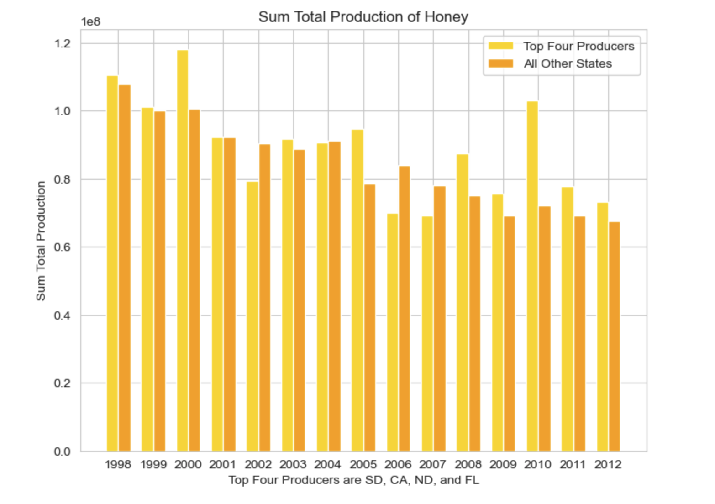
Top 4 producers compared to 36 states:
Notes:
At this point in my analysis, I started comparing top and bottom producers:
Top producers: ND, CA, SD, FL
Bottom producers: the remaining 36 states
Note: I should note that we are missing a lot of states here. 10 states are missing.
That would be interesting to have that data and see if and how that changes this story.
At this point, I was curious to look more closely at total production and stocks between top and bottom producers.

Slide 21
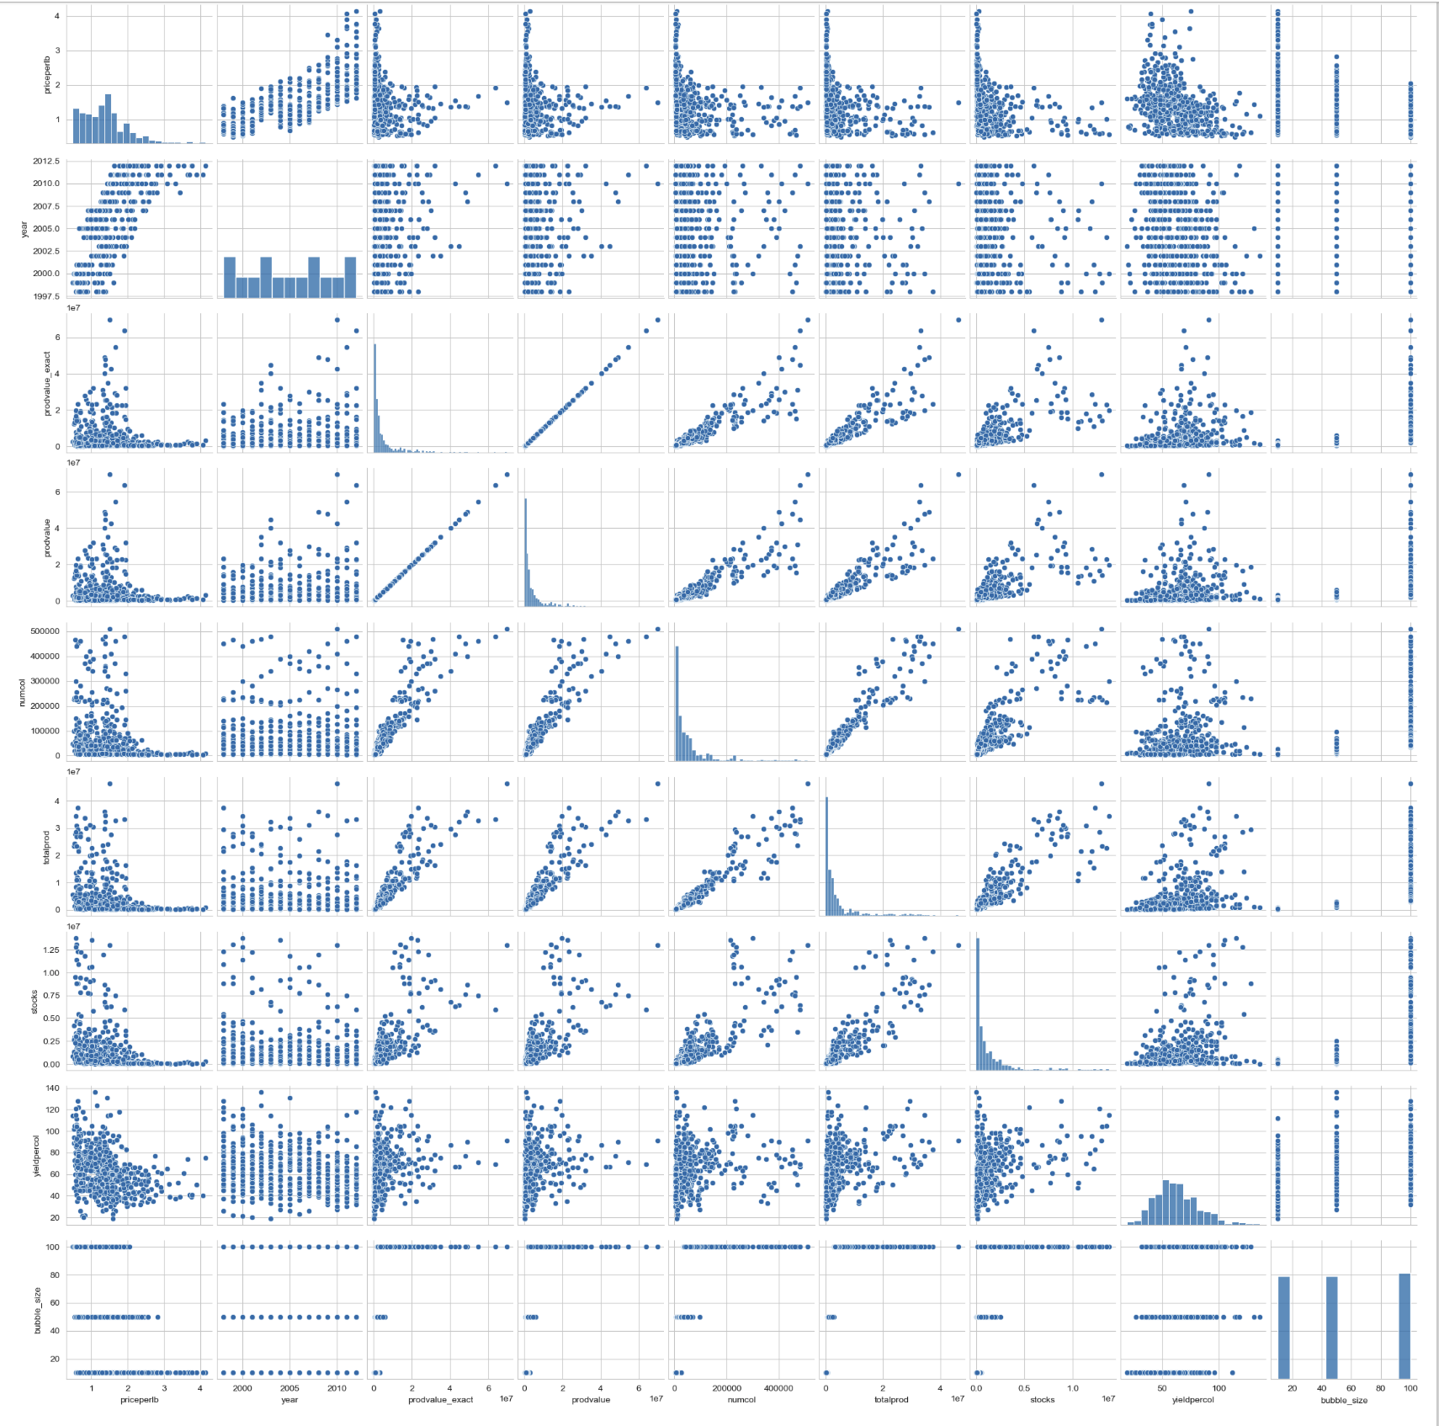
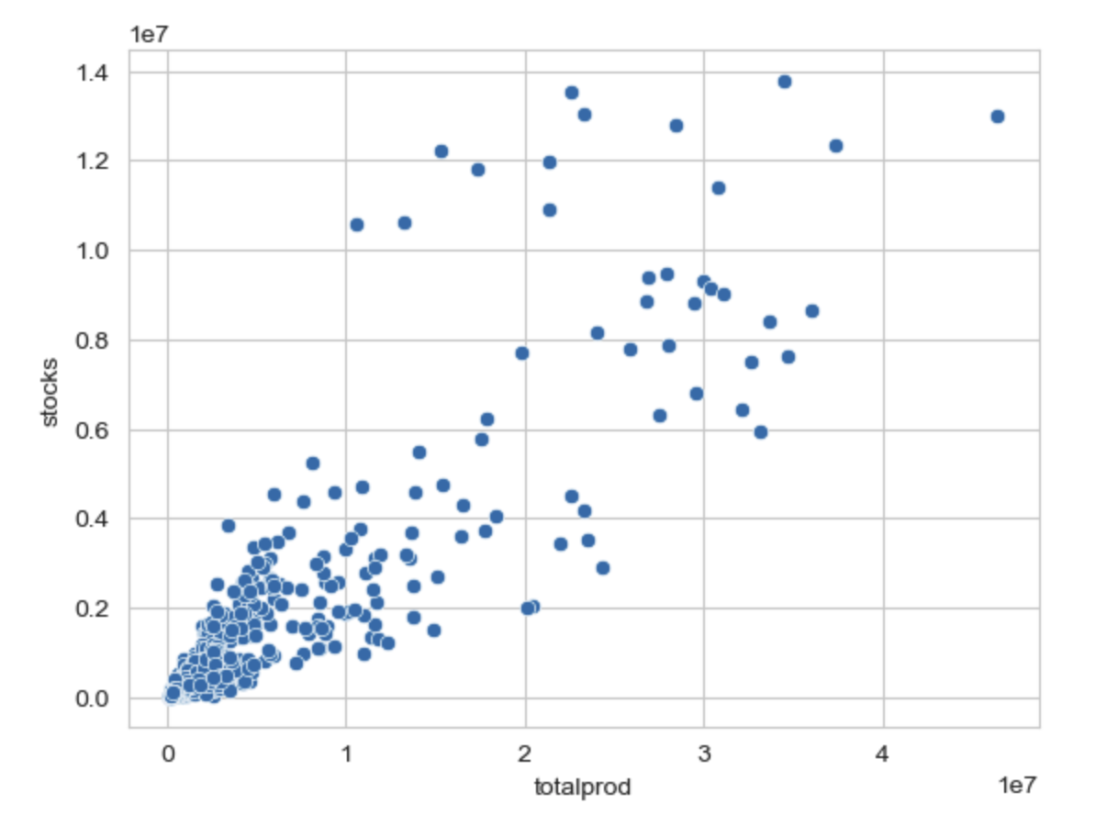
Stocks and production in the top and bottom producers
Notes:
What are stocks?
I knew that stocks were honey reserves held back by producers (as defined in the data set), but I did not really understand what role they played. I also did not have a lot of luck getting any insights online.
So I did some research. (Farmer’s market) (USDA) I made some phone calls to a major honey producer in Washington state.
And had a nice conversation.
Honey is not like other crops. It does not spoil.
Honey purveyor at farmer’s market - ‘honey is like wine’. He has jars going back decades.
(Ancient Egyptian honey)
The WA honey producer I spoke with explained that honey is held back for two reasons:
Wholesalers have too much stock - not buying
Prices were too low, so they hold some over in the hopes that they can sell it for more the following year.
Looking at stocks and total production…
Pair Plot:
Looking at stocks and total production…

Slide 22
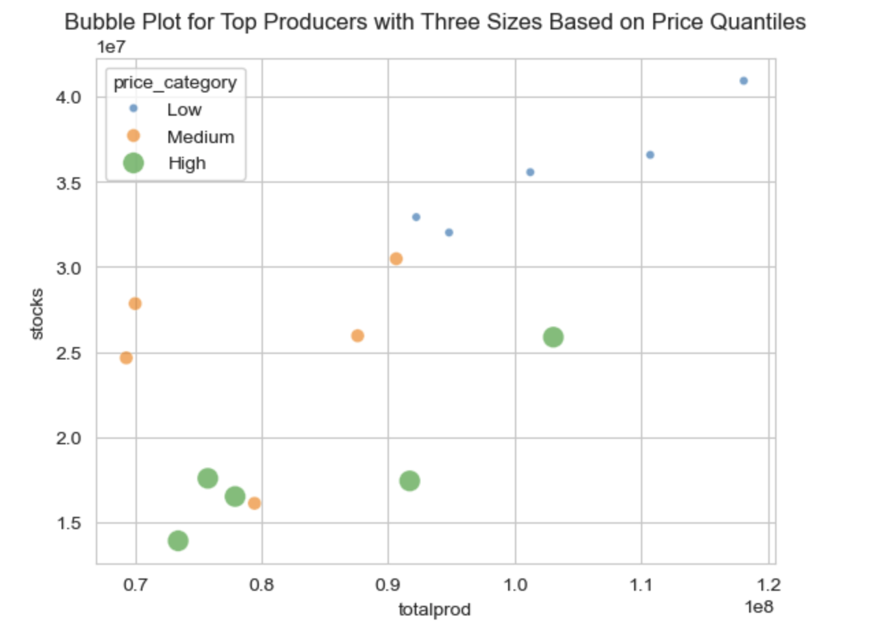
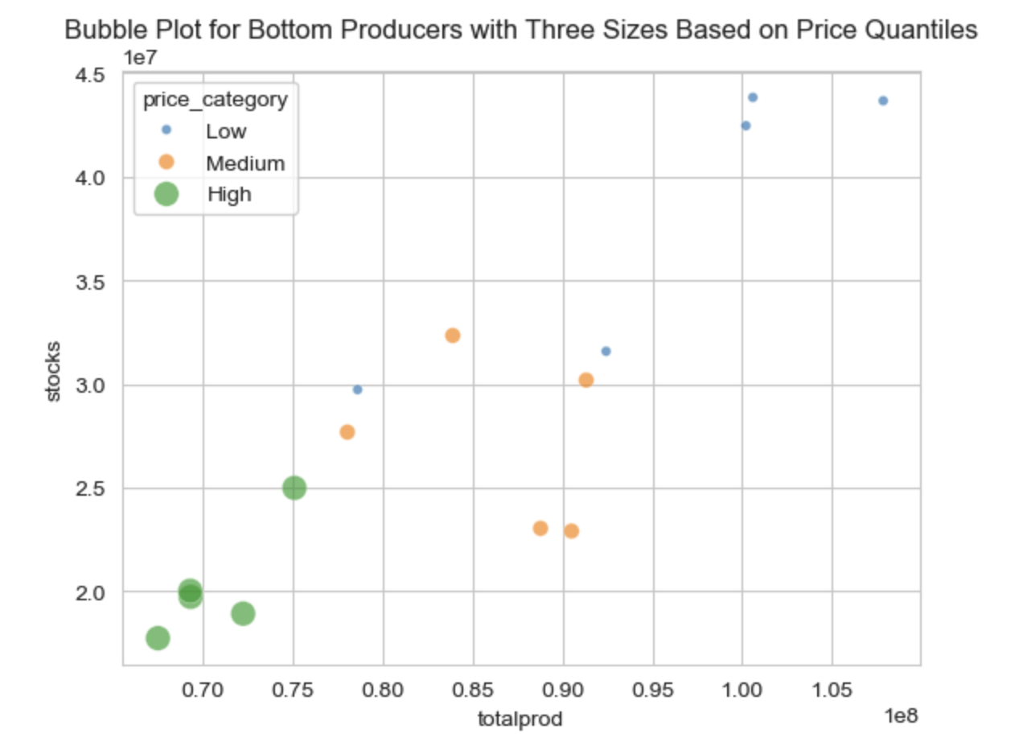
Top Producers​
Bottom Producers
Notes:
Bubble plot:
Looking at three variables: stocks and production by top and bottom producers. Price is the third variable here, represented by bubble size and color.
Each bubble represents one of 3 price tiers:.
Low: $0.49 - $1.71
Medium: $1.72 - $2.93
High: $2.94 - $4.15
Can see how top and bottom producers compare a little better here (next slide) …

Slide 23
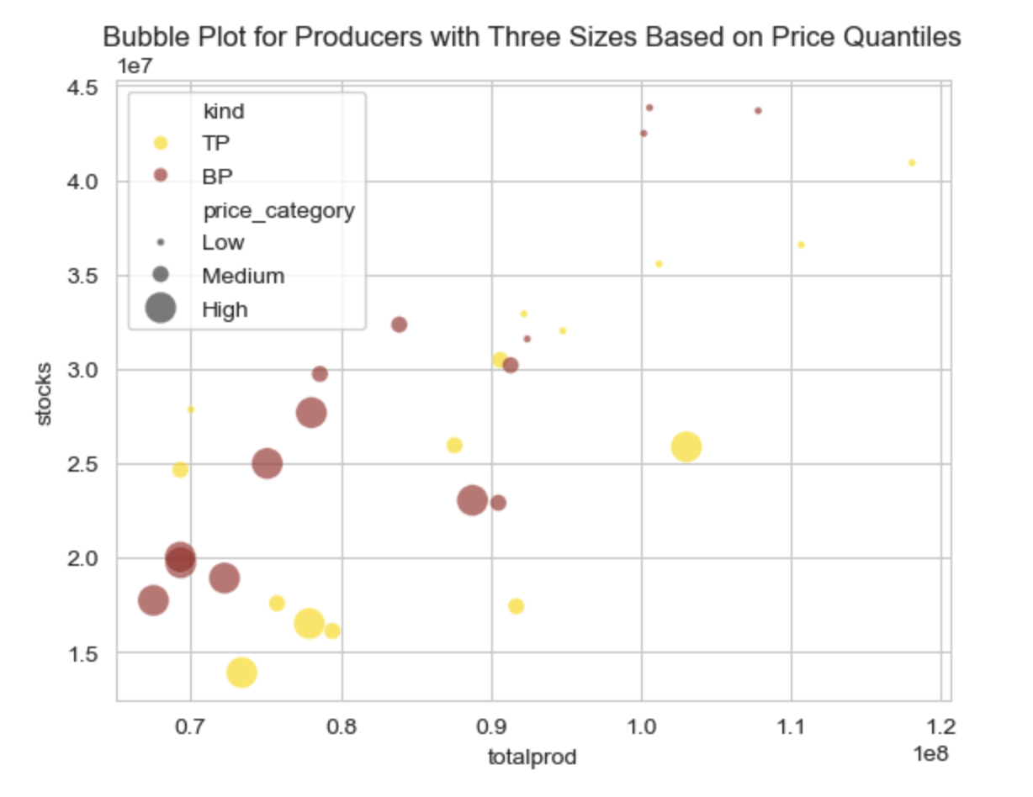
Top and Bottom Producers
Notes:
Top producers: gold - lighter color
Bottom producers: brown - darker color
Bubble size represents a price range:
[ Price varies from $0.49 per pound to $4.15 per pound over 15 years. ]
Low: $0.49 - $1.71
Medium: $1.72 - $2.93
High: $2.94 - $4.15
Even though top producers are responsible for more total production, bottom producers are actually holding back more stocks.
Bottom producers generally have more expensive honey and withhold more inventory.
[ Does not seem to depend on state (not a brand issue) ]

Slide 24
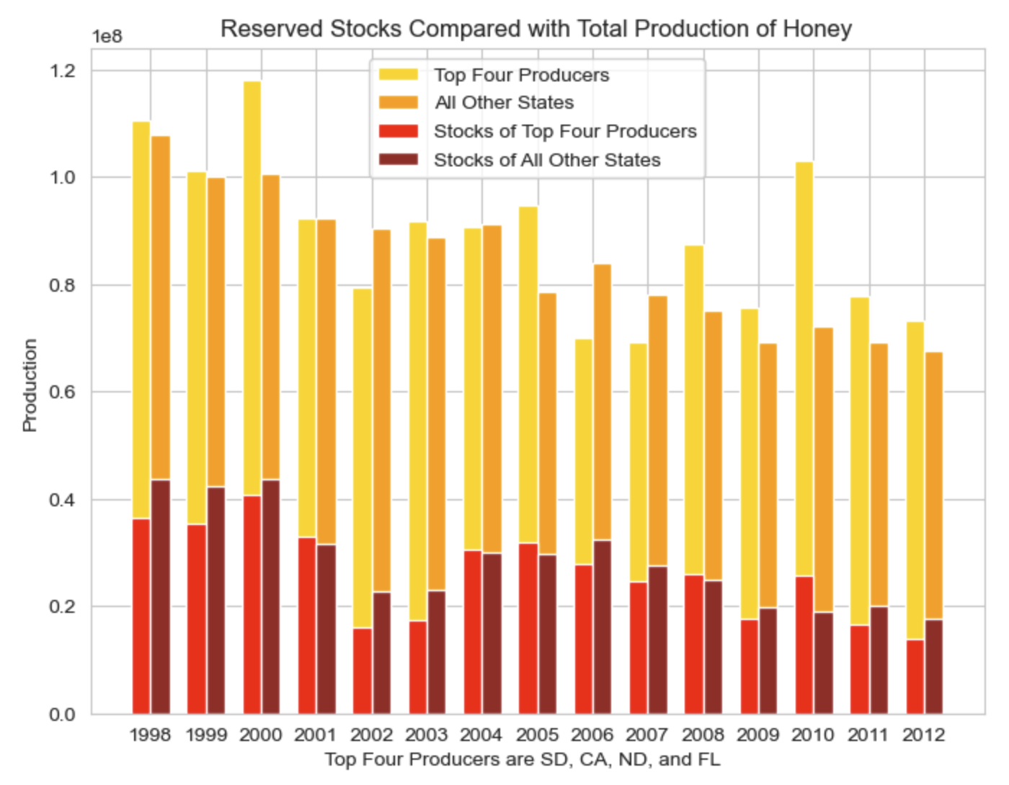
Stocks and Total Production for Top and Bottom Producers
Notes:
Here is a comparison of how stocks and total production trend with top and bottom producers.
In general, the top four producers are holding back less stock than the rest of the states.
Or, put another way, the top four states, with the cheapest prices are moving more honey.
The top four states are producing half the total honey consumed in the US.
The top four states have some of the lowest honey prices.
They hold back fewer stocks, just barely.
The rest of the states, with more expensive honey, move less honey and hold back more stocks.
(Stocks and production correlate very highly.)

Slide 25
Four states are responsible for over 50% of US honey production:
ND, CA, SD, FL
States with lowest levels of production:
ME, KY, VA
Highest average prices of honey:
VA, IL, KY
Lowest average prices of honey:
LA, MS, AR
Conclusions:
Notes:
In conclusion:
Four states are responsible for over half the honey produced in the US.
ND, CA, SD, and FL
These states are responsible for a lot of product.
And they offer some of the cheapest honey. They are not the cheapest, but they are in the bottom ten states for honey prices.
If you were setting up honey production business, which states would be a good choice?
These top producing states are probably not a good place to start a honey production business
unless your business model can handle some of the lowest honey prices in the industry.
The states getting the highest prices, on average, for their honey are VA, IL, and KY.
Although they are not moving as much honey as states with cheaper honey.
[If you are buying honey, LA, Mississippi and Arkansas have the lowest prices on average.]
A honey production business would need to consider how price point and volume will affect their business needs.
If you are not able to support a large volume of production, you will probably want to charge more:
being in a state with a market that can support higher prices might suit you better: VA, IL, KY
On a final note:
Be careful with your EDA! My first dataset had more recent data and a Kaggle usability ranking of 10.0! But this did not pan out.
[next slide]
—————————————————
Stats:
Most expensive honey on average: VA, IL, then KY $$$$$
Cheapest honey on average: LA, Mississippi (MS), then Arkansas (AR) $
Highest price honey:
state year
HI 2012 $4.15/lb
VA 2011 $4.07/lb
IL 2011 $3.90/lb
Lowest price honey:
state year
LA 1999 $0.49/lb
2000 $0.52/lb
ID 2000 $0.52/lb
FL 1999 $0.53/lb
Lowest average production levels: Maine (ME), KY, VA
Largest number of colonies:
ND, CA, ND… as you would expect
Smallest number of colonies:
KY 1998 3000.0
1999 3000.0
ME 2012 4000.0
2011 4000.0
VT 2010 4000.0
2011 4000.0
Highest yield per colony:
HI 2002 136
2005 131
ND 1998 128
LA 2002 124
MT 1998 122
SD 2000 121
MS 2012 118
HI 1998 118
MS 2011 115
ND 2000 115
Lowest yield per colony:
NJ 2003 19
ME 2001 20
2000 21
1999 22
2006 23
2005 26
2007 26
1998 26
ID 2010 27
NJ 2004 27

Slide 26
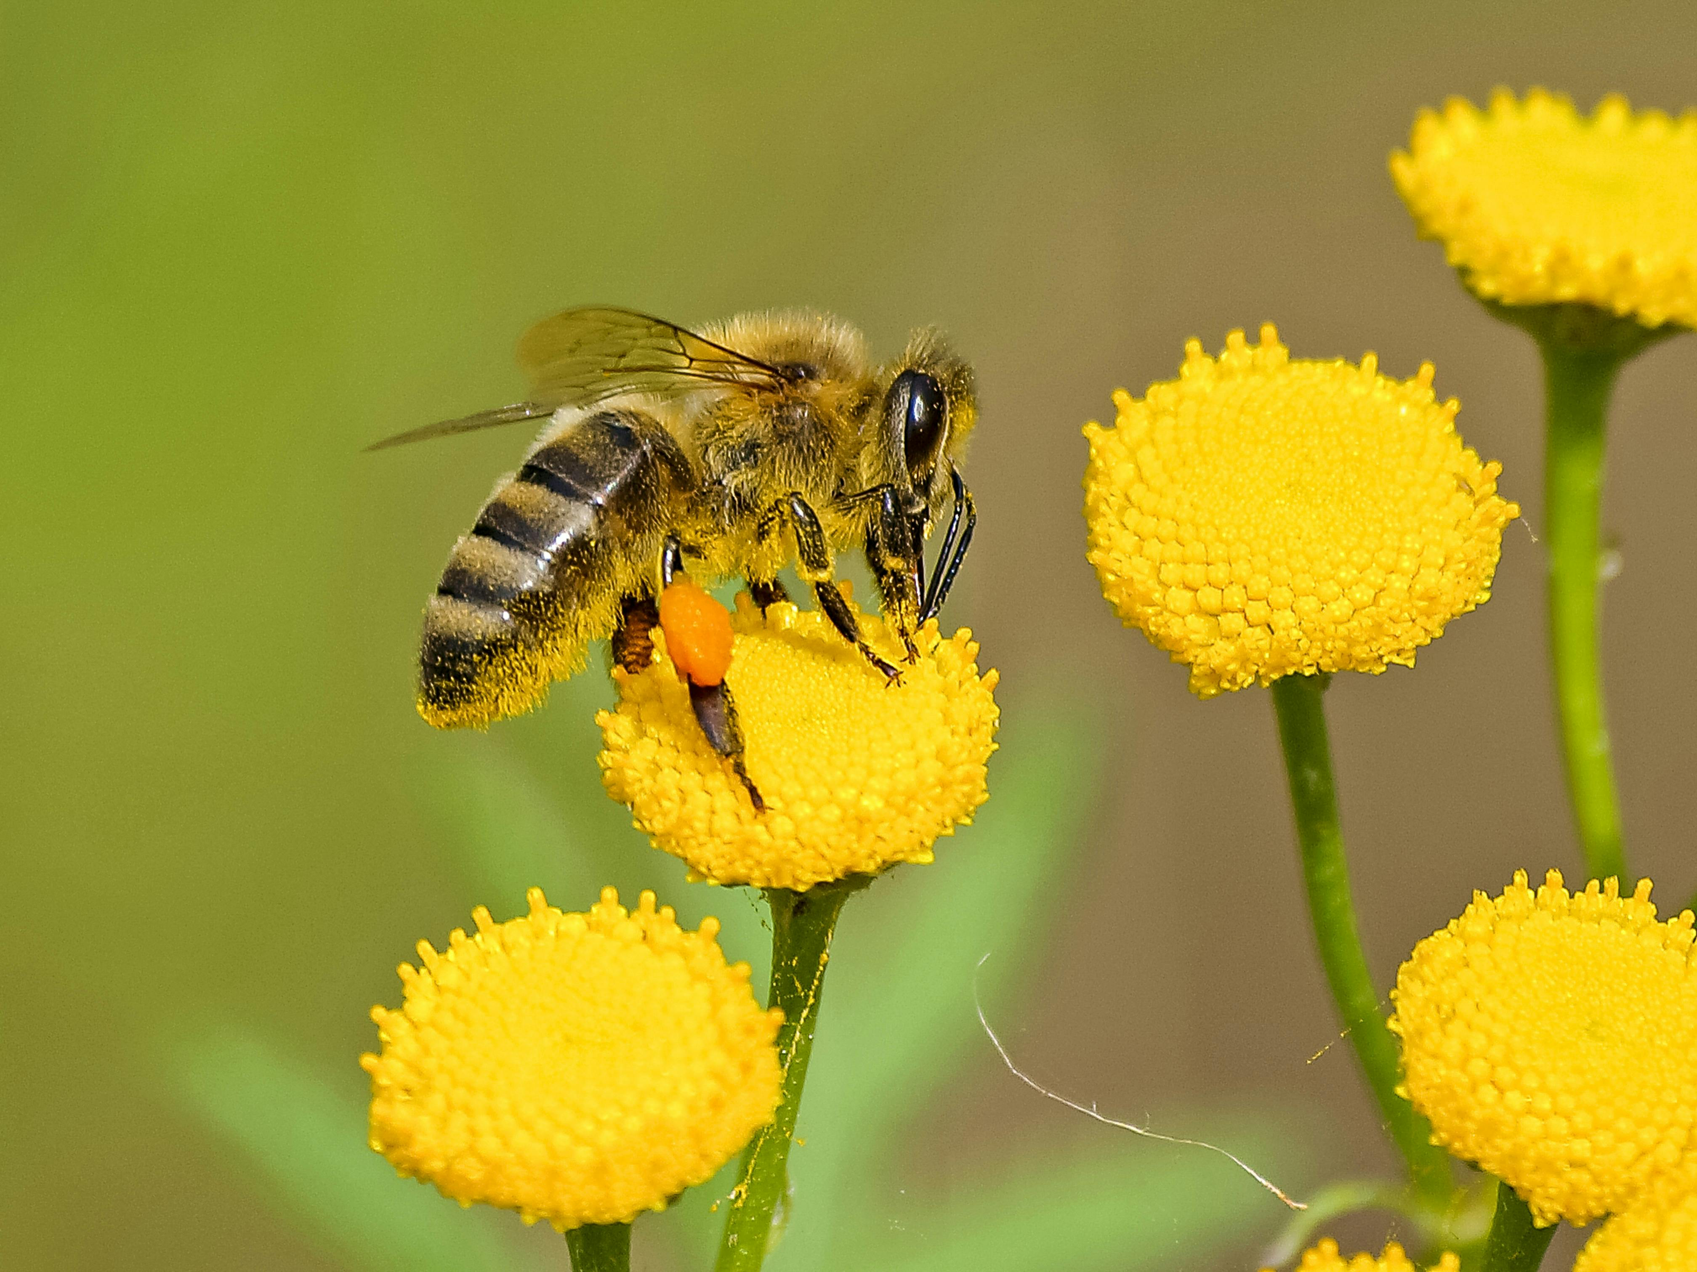
Further Research:
Relationships between crops and honey production
Photo by Pixabay: https://www.pexels.com/photo/brown-and-black-bee-on-yellow-flower-nectar-460961/
Notes:
Further Research:
Crops as drivers of honey production.
It would be interesting to better understand the relationship between crops and honey production.
What about SD (and ND) make these prime states for honey production?
CA grows a lot of crops. I think of almonds, which need bees for pollination.
North and South Dakota grow a lot of self-pollinating crops like wheat and corn.
But I remembered driving through North Dakota many years ago – all the sunflowers!!
Bees are essential to sunflower pollination.
North Dakota and South Dakota are primary producers of sunflower in the US, by a lot!
North Dakota: 1,122,980 (1000s lbs) - 1.1 billion pounds
South Dakota: 817,200 (1000s lbs) - 817 million pounds
Minnesota: 132,000 (1000s lbs) - 132 million pounds
Texas: 61,250 (1000s lbs) - 61 million pounds

Slide 27
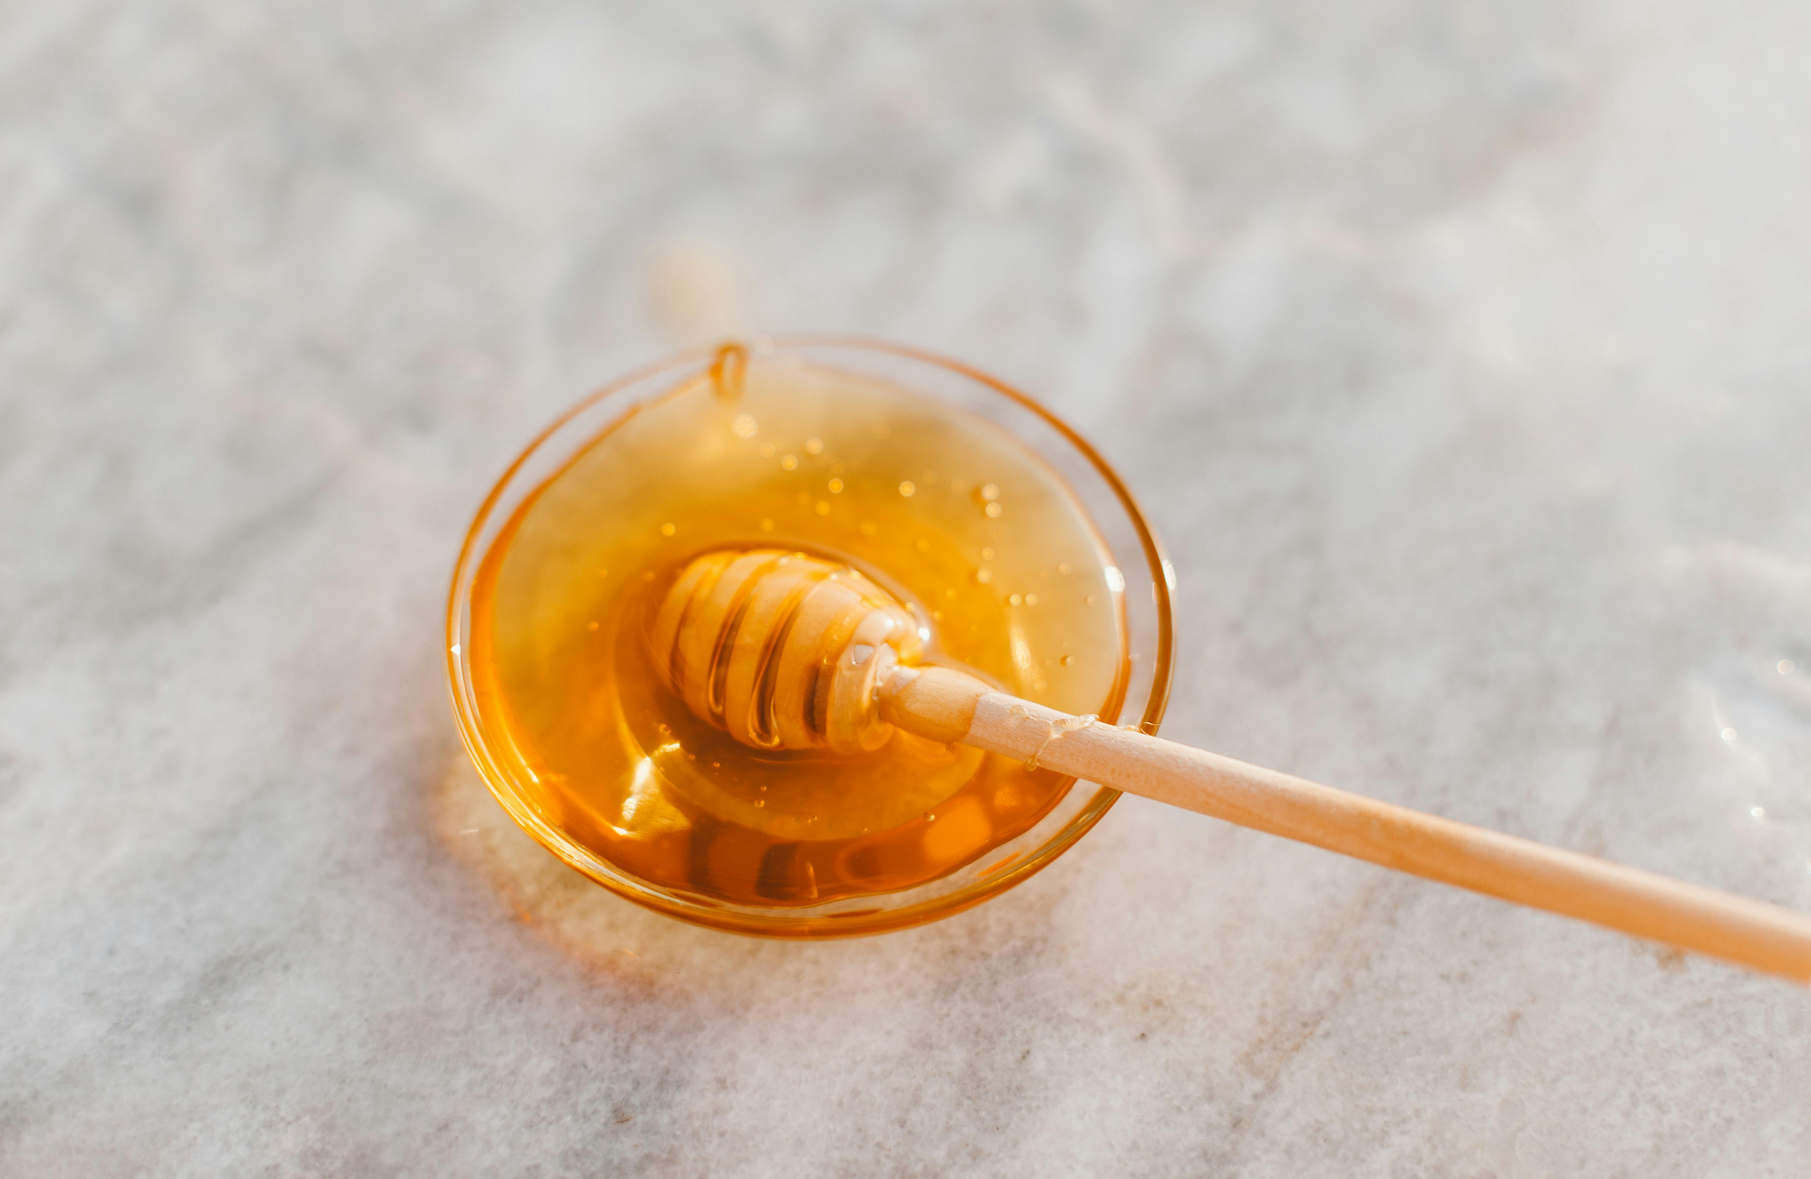
Special Thanks To My Mentors:
Vinod Chugani
Philippe Heitzmann
Photo by ROMAN ODINTSOV: https://www.pexels.com/photo/spoon-of-honey-6422029/

Slide 28
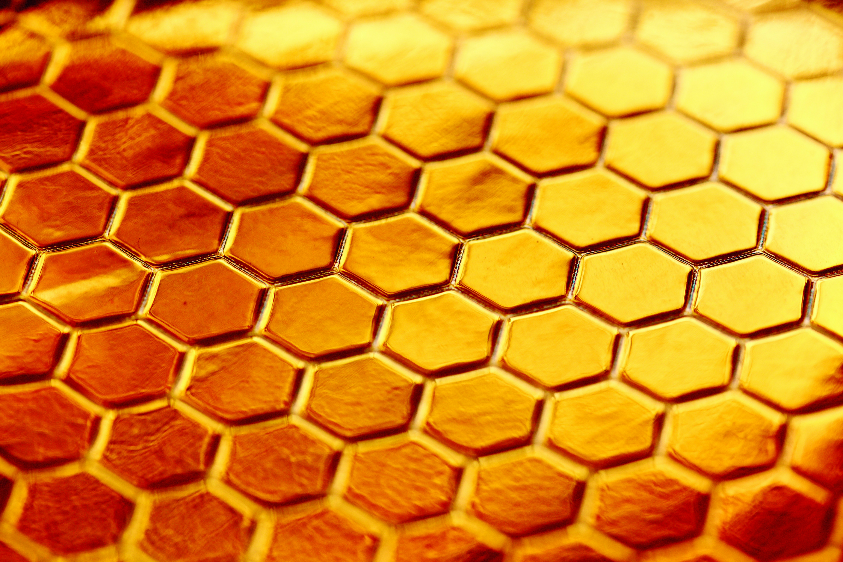
Questions
Photo by Alexander Grey, Unsplash
Notes:
Thank you so much for listening.
Are there any questions?

